Slide 1





SMART INDIA HACKATHON 2026
  Problem Statement ID –26172
  Problem Statement Title-Low Latency and Efficient Voice Activator for Edge Devices
  Theme- Smart Automation
  PS Category- Hardware
  Team ID-
  Team Name- SEVA

Slide 2
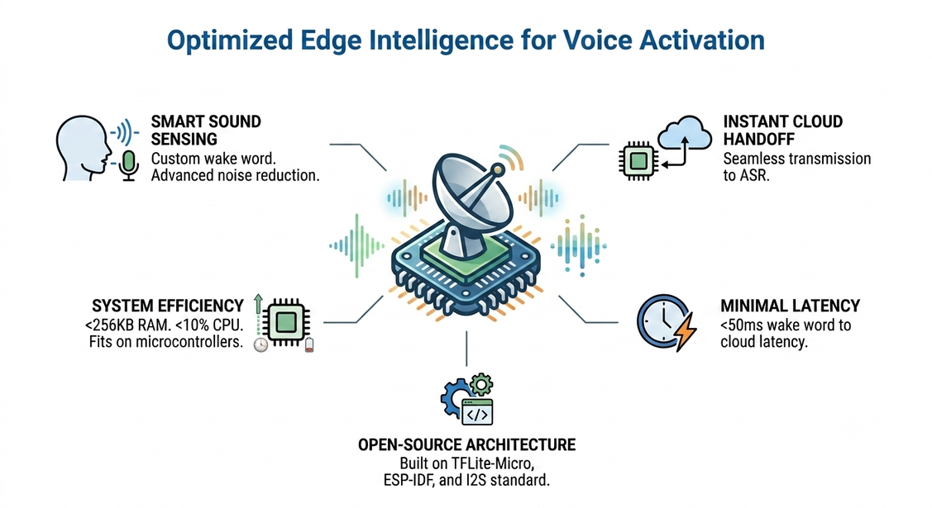
EchoEdge Low Latency & Efficient Voice Activator
for Edge Devices
SEVA
Proposed Solution:
Developing an open-source, PyTorch-based voice activator with on-device wake-word detection (custom TinyWakeWordNet) that streams live audio to Moonshine ASR over WebSocket.
Addressing the Problem:
Enables instant voice activation without continuous, battery-draining cloud streaming.
Operates strictly within system limits (<256KB RAM and <10% idle CPU).
Uses 100% open-source components (PyTorch, Piper, Moonshine) with a custom wake word, removing reliance on costly commercial SDKs
Solution Overview:
(targeted)
On-Device Keyword Spotting: Runs TinyWakeWordNet (custom DS-CNN, 37.7KB) for offline trigger-word detection.
Smart Audio Streaming: Uses a pre-roll buffer and persistent WebSocket to stream raw audio to Moonshine ASR.
Debounced Triggering: Requires 2 consecutive detections before firing, cutting false accepts 12x in testing.
2
Notes:
2

Slide 3
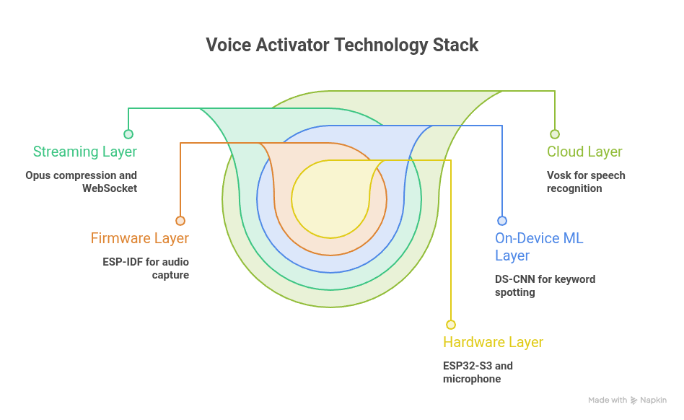
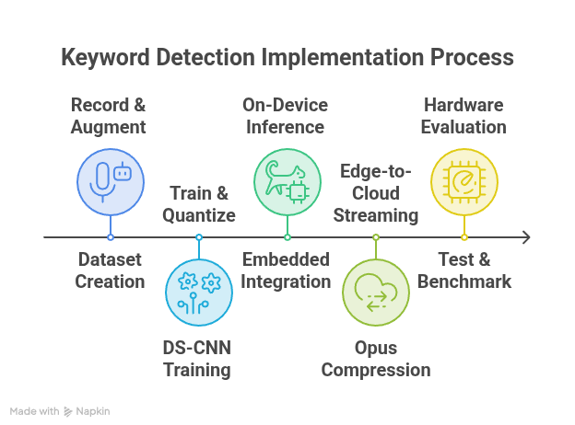
TECHNICAL APPROACH
SEVA
Technologies to be used
Hardware: ESP32/ESP32-S3 (target) + I2S MEMS mic | Languages: Python (training), C/C++ (planned) | On-device ML: PyTorch — TinyWakeWordNet (DS-CNN, 37.7KB) | Dataset: Piper TTS across 84 voices | Streaming: WebSocket + raw PCM16 | VAD: Silero VAD | Cloud ASR: Moonshine (open-source, MIT)
moonshine
Methodology and process for implementation
Phase 1 Synthetic data (Piper TTS, 84 voices) → Phase 2 Train DS-CNN with real-speech negatives (LibriSpeech) + SpecAugment → Phase 3 Live pipeline (mel features, pre-roll buffer, debounced confirmation) → Phase 4 Persistent WebSocket streaming to Moonshine ASR → Phase 5 5.4-hour false-accept soak test (12x improvement) + LOSO validation
3
Notes:
3

Slide 4



FEASIBILITY AND VIABILITY
SEVA
Technical Feasibility
  Uses standard components including ESP32 microcontroller and INMP441 digital MEMS microphone as the target deployment hardware.
  Targets <256KB RAM, <10% CPU with a custom DS-CNN (TinyWakeWordNet) — already measuring 37.7KB, 0.64ms inference.
  Uses PyTorch for training, with Piper TTS generating synthetic data across 84 voices for rapid dataset creation.
Execution Viability
  Eliminates procurement delays and API billing overhead by using existing hardware, an open-source pipeline (PyTorch, Piper TTS), and Moonshine ASR, hence architecture is low-cost.
  Our team follows a realistic timeline with clearly delineated team roles handling parallel workflows (Data Collection, Firmware, ASR Integration, and Testing).
Risk Mitigation
  A 5.4-hour false-accept soak test on real unheard speech found 120.6 false triggers/hour — fixed to 10.3/hour (12x) via real-speech negatives (LibriSpeech).
  Leave-one-speaker-out validation: 98.6% on known voices vs. 71-75% on unseen speakers — closing this gap with more speaker recordings.
4
Notes:
4

Slide 5








IMPACT AND BENEFITS
SEVA
TARGET AUDIENCE : ISRO and other edge/embedded-device users (satellites, ground stations, remote sensors, mission control interfaces)
IMPACTS
BENEFITS
ECONOMIC: No licensing fees (open-source stack only) — no recurring SaaS/SDK cost vs. commercial voice SDKs; reuses existing ESP32 hardware (no new procurement)
STRATEGIC/NATIONAL(ISRO SPECIFIC): Indigenous, custom-trainable keyword system — no reliance on foreign proprietary voice tech, aligns with Atmanirbhar Bharat / self-reliance in critical space-tech components
ENVIRONMENTAL: Ultra-low idle power draw → suited for solar/battery-powered remote sensor nodes; less energy overhead than cloud-polling alternatives
TECHNICAL/SCALABLE: Framework is keyword-agnostic — same pipeline can be retrained for other ISRO use cases (defense, disaster response ground units, industrial IoT) beyond this one PS
SOCIAL: Improves accessibility of embedded systems for operators in noisy/hazardous field conditions where manual input is impractical
Enables hands-free, low-power voice control for ISRO ground station operators and field engineers working in mission-critical environments where hands are occupied or gloves/suits are worn
Removes dependency on cloud-always-on voice assistants (Alexa/Google) — critical for ISRO where data sovereignty and offline operation in remote/low-connectivity sites (launch pads, tracking stations) matter
Cuts response latency for voice-triggered systems, useful in time-sensitive telemetry/command scenarios
Extends battery life of edge devices used in remote sensing units, rovers, or unmanned ground stations since the wake-word engine idles at <10% CPU
5
Notes:
5

Slide 6
RESEARCH AND REFERENCES
SEVA
Solution | Open-source | Custom keyword | Fits PS constraints
Google / Alexa wake word | ✗ | ✗ fixed | ✗ banned by PS
Porcupine (Picovoice) | ✗ proprietary | ✓ paid console | ✗ commercial SDK
Espressif ESP-SR / WakeNet | Partly – training closed | Limited / paid service | ✗ fails open-pipeline rule
★ Our approach: TinyWakeWordNet + Moonshine | ✓ | ✓ self-trained | ✓ meets every constraint
Key references
  T. N. Sainath & C. Parada (2015), "Convolutional Neural Networks for Small-footprint Keyword Spotting," https://www.isca-archive.org/interspeech_2015/sainath15b_interspeech.pdf
  Y. Zhang, N. Suda, L. Lai & V. Chandra (2017), "Hello Edge: Keyword Spotting on Microcontrollers" — arxiv.org/abs/1711.07128
  P. Warden (2018), "Speech Commands: A Dataset for Limited-Vocabulary Speech Recognition" — arxiv.org/abs/1804.03209
  LiteRT for Microcontrollers, official documentation — ai.google.dev/edge/litert/microcontrollers/overview
  Moonshine, open-source streaming ASR toolkit — github.com/usefulsensors/moonshine
  Espressif ESP-SR / WakeNet (industry reference compared above) — github.com/espressif/esp-sr
  Panayotov et al. (2015), LibriSpeech corpus — used for the false-accept soak test — openslr.org/12
  Piper TTS, used to synthesize training data across 84 voices — github.com/rhasspy/piper
  Silero VAD, voice activity detection for the streaming pipeline — github.com/snakers4/silero-vad
6
6
Notes:
6

